Slide 1
Olympics – Project 1
Group 7 –
Benjamin Bagby
Traci Ellis
Katrina Medina
Homar Ortiz

Slide 2
Olympics – Content
Which Olympic athletes have the most gold medals? Which countries are they from, and how has the landscape of the sports changed over time?
More than 35,000 medals have been awarded during the Olympic games since 1896. During the first two Olympiads silver medals and an olive wreath were awarded to the winner, shortly thereafter, the IOC began awarding gold, silver and bronze medals to the top athletes based on their rankings.
This dataset includes a row for every Olympic athlete who has won a medal since 1896.

Slide 3
Olympics – Purpose
Purpose: After reviewing the dataset, we decided to analyze this dataset that presents the information of all the athletes that have won medals in both the summer and winter Olympics from 1896 until 2014.
However, for the purpose of this project, we will be focusing on the data related to both the summer and winter Olympic since their first competition after WWII (1948-2014)
Each group member has posed a question regarding the data and have completed the analytics on their question as well as will be presenting their findings.

Slide 4
Olympics – Questions
Which Country has won the most medals, overall, in the Summer Olympics? We will be looking at 3 individual events of the sport of Gymnastics (Vault, Individual All Around, & Floor Exercises) where men and women were equally represented. - Traci
One of the most popular Olympic event categories is Track & Field. Which countries have had historical success in the events under the umbrella of the Track & Field category? - Benjamin
For Speed Skating, how much of an effect does the population of a country correlate on whether that country would receive the most medals? – Katrina
Which are the top 3 countries with most medals won (per athlete, not event) per competition? How has this changed over time? How does it compare between the Summer/Winter Olympics? - Homar

Slide 5
Question: 1- Traci
Which Country has won the most medals, overall, in the Summer Olympics? We will be looking at 3 individual events of the sport of Gymnastics (Vault, Individual All Around, & Floor Exercises) where men and women were equally represented.

Slide 6
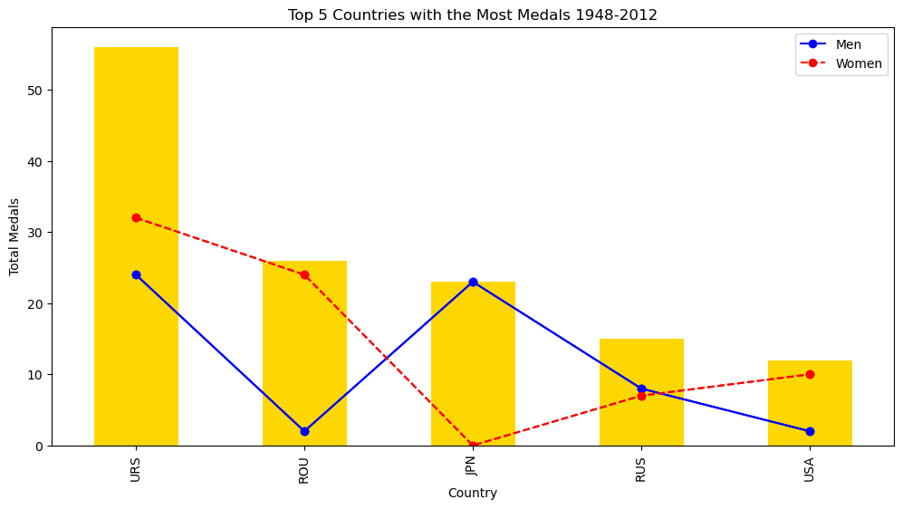
Top 5 Countries with the Most Medals
URS- USSR Prior to 1991
ROU- Romania
JPN- Japan
RUS- Russia Post 1991
USA- USA
Notes:
On average, over the course of a Summer Olympiad, there are over 200 countries that are being represented. Take into effect, for each event, about 30-40 participants per event and for 3 events like the Vault, Floor Exercises and Individual All Around we could have approx. 120-160 athletes competing for Gold. Only one Gold Medal per gender is awarded per event. From 1948-2012 there were 144 medal winners from their respective countries. But, who were the top five countries who had the most medal winners?

Slide 7
USSR vs. USA a Timeline Analysis
Notes:
From 1950 until 1990 – the USSR was a powerhouse in the field of Gymnastics (specifically in the 3 events analyzed), as you can see from the data the US never won a medal in the 3 events until about 1976. And even then, the USSR surpassed the US by winning 6 medals compared the the US’s 1 medal during that same year. After the fall of the Soviet Union in 1991 we do not see a Eurpoean uptick again until the 1994 games when post USSR, Russia brings home the most medals that year. The Post USSR Countries that won medals in our dataset included Russia with 15 medals, Belarus with 1, Ukraine with 2 and Latvia with 2 medals. Even with the breakup of the Soviet Union it is clear to see that they remain a powerhouse in the sport up to 2012.

Slide 8
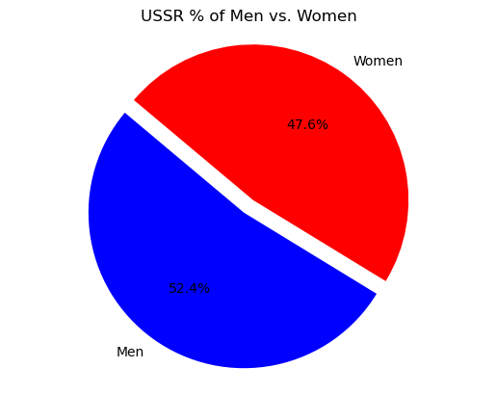
USSR % of Men vs. Women
Notes:
From 1948 to 1991 the USSR- Soviet Russia was a powerhouse when it came to the sport of gymnastics especially in the co-ed events of the Vault, the Individual All Around and the Floor exercises. if we were to do a deeper dive, and include all events we would probably see an increase in those medals. I only wanted to look at events that both men and women competed in individually and removed all team events and single gender events. After the fall of the USSR the Soviet Union was broken into their own independent countries and i wanted to see if those coutries would have still contributed to the USSR's success after post 1991. and Russia along with 3 other countries combined brought home an additional 20 medals after 1992. we can further see from the data that the United States did not become more competitive in the sport of gymnastics until after 1978.

Slide 9
Question #2 - Ben
Which countries have brought the most medals back home since the end of World War II?
In this analyzation, only individual events will be taken into consideration
Medal totals will be broken up into 4 categories (Gold, Silver, Bronze and Total)
The top countries will be compared against GDP per capita to see if there is any correlation

Slide 10
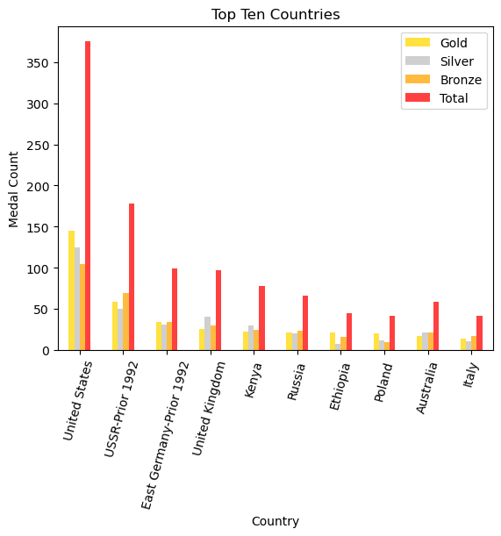
The Top Performers
Observations
The two post WWII superpowers (USSR and USA) were the most dominant
English speaking nations are amongst the elite tack and field althetes
Outside of the top 2 performers, medal share seems to be evenly distributed

Slide 11
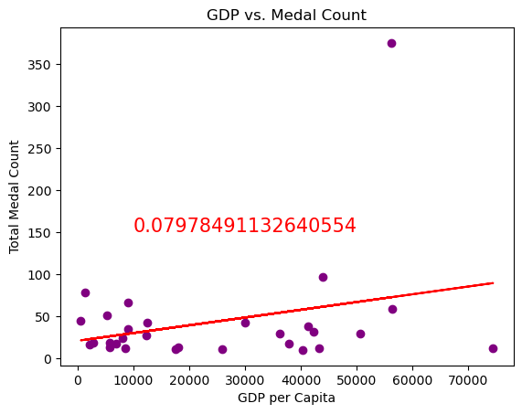
GDP per Capita Comparison
Observations
There appears to be one statistical outlier (probably the USA)
With a r² value of .079, there seems to be little to no correlation between the two variables
There would be almost no relationship if the statistical outlier was taken away from the model

Slide 13
Add a Slide Title - 4

Slide 14
Add a Slide Title - 5

